Slide 1
Homework #3
2018 Fall, GCT522, Computer Graphics Theory and Application
Jungeun Yoo
2018.10.01

Slide 2

Homework #3
Camera Path Generation

Slide 3
Goal
Get familiar with python scripting and its maya api
Utilize what you learned about transformation

Slide 4
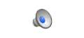
Goal – Part 1: Camera Placement

Slide 5
Goal – Part 2: Camera Path Keyframing

Slide 6
Setting for Python scripting
Same as homework #1
Windows > General Editors > Script Editor
No need to import plugin, shutdown Maya when it fails to work…
But… writing a code in Script Editor is tedious…
When using other editor, however, you have to open it every time you save!

Slide 7

Setting (optional)
Install the ‘Atom’
http://atom.io
Install ‘Maya’ package in Atom
https://atom.io/packages/maya

Slide 8
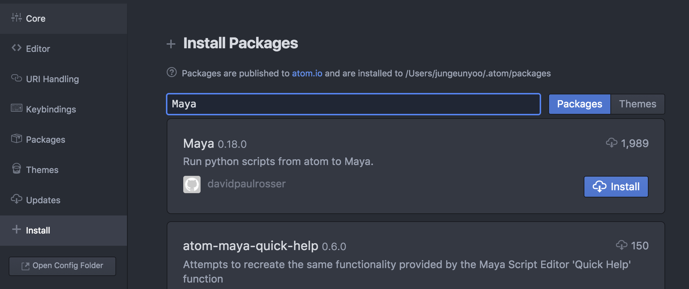
Setting (optional)

Slide 9
Setting (optional)
Open Maya script editor
Write code as below
Save the code
/Users/<user>/Library/Preferences/Autodesk/maya/<version>/scripts/userSetup.py
Run the code
Now, any python code worked in Atom can be directly executed in Maya by pressing ctrl+alt+R

Slide 10
Requirements
Create python graphical user interface (0.5 points)
Select target/curve of your choice
Change the direction and distance for camera placement
Change pacing of camera movement through user input
Create and use mathematical functions(1.0 points)
createRotationMatrix, vectorAngle
Create and place camera to given direction and distance (1.5 points)
Camera located at right distance and direction(right, left, front, back) – 1pt
Camera looking at the target – 0.5pt
Move camera along the curve (3.0 points)
Keyframe camera to follow the curve– 1pt
Keyframe camera to look at the target– 2pt

Slide 11
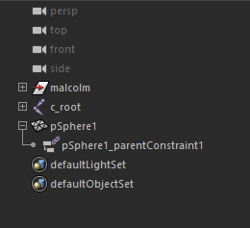
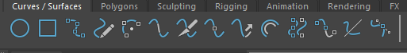
Maya scene
Following objects will be given in the scene
malcolm: a character
pSphere1: sphere attached to malcolm’s head (target)
Following objects should be created by users
camera (within code)
curve (drawn by users using pencil curve tool)

Slide 12
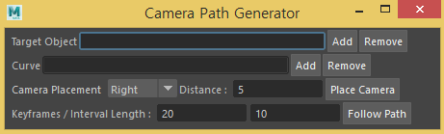
GUI
Camera Placement
Right, Left, Front, Back
Distance
distance between camera and the target
Keyframes
Number of keyframes
Interval length
Number of frames between keyframes
Be Creative as much as you like!

Slide 13
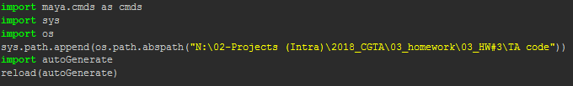
General Tips
How to import python file

Slide 14
General Tips
numpy library
Offers helpful functions for mathematical calculation
https://forums.autodesk.com/t5/maya-programming/guide-how-to-install-numpy-scipy-in-maya-windows-64-bit/td-p/5796722

Slide 15
General Tips
How to get and set attribute value
cmds.getAttr(…)
cmds.setAttr(…)
How to set keyframe
cmds.setKeyframe(objectname)

Slide 16
Camera Placement (1.5pt)
Camera located at right distance and direction (1pt)
Height of the camera is same as the target
Camera should be placed in a right direction regardless of target’s configuration
However, the target will only rotate in y-axis
Camera looking at the target (0.5pt)
Don’t use lookAt command

Slide 17
Place camera to given direction and distance
Camera placement direction
Target’s front is its local positive z-axis direction
Say that the target is at (0,0,0) and looking at global z-axis, vector direction relative to the target will be:
Left: (1,0,0)
Right: (-1,0,0)
Front: (0,0,1)
Back: (0,0,-1)
back(0,0,-1)
x
right(-1,0,0)
Left(1,0,0)
z
Front(0,0,1)

Slide 18
Move camera along the curve (3pt)
Keyframe camera to follow the curve (1pt)
Don’t use pathAnimation command
Keyframe camera to look at the target (2pt)
Use OpenMaya API
Don’t use lookAt command

Slide 19
Camera running on a curve
Keyframe camera to follow the curve (1pt)
Place curve on the same height as the target
Curve information
cmds.pointOnCurve(curve, parameter, p=True)
parameter = 0
parameter = 0.7
parameter = 2.1

Slide 20
Camera running on a curve
Keyframe camera to look at the target (2pt)
Get angle between two vectors & orthogonal axis (using cosine law and cross product)
*Camera’s view direction is (0,0,-1)

Slide 21
Camera running on a curve
Keyframe camera to look at the target (2pt)
Helpful OpenMaya function
import maya.OpenMaya as om
…
quaternion = om.Mquaternion(angle, axisvector)
euler = q.asEulerRotation()

Slide 22
References
Maya 2017 python API reference
http://help.autodesk.com/view/MAYAUL/2017/ENU/?guid=__py_ref_index_html
Python scripting
https://www.learnpython.org/

Slide 23
Submission files
Source code :
.py (1 for maya GUI, 1 or more for main implementation)
Readme.txt file :
Target Machine & software(ex. Maya 2017, python 2.7)
How to use your GUI
How each of your function works
Screen Capture Video file:
Result scene in .mp4/.avi/.gif format

Slide 24
Submission files
Source code :
.py (1 for maya GUI, 1 or more for main implementation)
Readme.txt file :
Target Machine & software(ex. Maya 2017, python 2.7)
How to use your GUI
How each of your function works
Screen Capture file:
Result scene in .png format
Upload your files to KLMS
Until 22th, October, 14:30

Slide 25
Q/A
Jungeun Yoo
jey920@kaist.ac.kr
#2344, N5 Building / Visual Media Lab. in GSCT

